Slide 1

Text Extractive Summarization using BERT
Submitted by :
Harshita Tanya Malik Aditya Khade
Under the Guidance of Prof Dr. Ranjan Behra
Date : 03 -12-2024

Slide 2
Text Summarization :
Text summarization is the process of automatically generating a shorter version of a document that captures its important points. It is significant because it allows you to quickly understand large volumes of material, helps you cope with the vast amount of information available today, and makes it easier to grasp the primary message of a document. Text summarization is used in applications such as news aggregation, email summarization, and academic research.

Slide 3
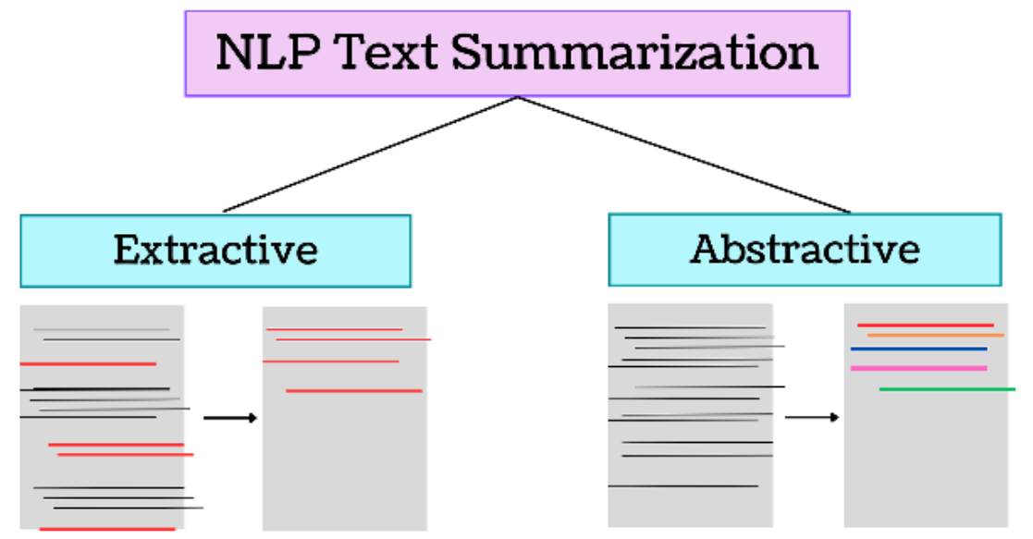

Slide 4
Abstractive vs. Extractive Summarization :
Abstractive
Generates new sentences that capture the essence of the text, similar to how a human would summarize.
Requires more complex models, often based on deep learning.
Example: Creating a summary that explains a complex document in simpler terms.
Extractive
Identifies and extracts the most important sentences from the original text to form the summary.
Retains the original structure and wording of the document.
Example: our project work on this approach.

Slide 5
Project Pipeline
Input Text
1
2
Preprocess
Embed with BERT
3
4
Cluster Sentences
Generate Summary
5

Slide 6
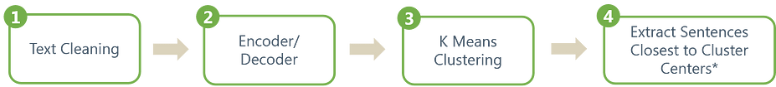

Slide 7
Text Preprocessing: Cleaning and Tokenization
Cleaning
Tokenization
Preparing text data for analysis by removing unwanted elements like HTML tags, URLs, stop words, and punctuation.
Remove any superfluous material, including stop words, special characters, and useless information.
Special characters (*@, #, , etc.)
Breaking down text into individual units (tokens) that can be processed by machine learning models.
Example: “The sky is blue.” → [The, sky, is, blue]

Slide 8
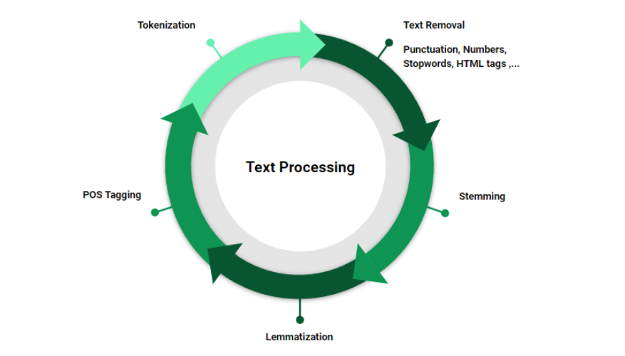

Slide 9
BERT and Extractive Summarization :
What is BERT?
BERT (Bidirectional Encoder Representations from Transformers) Developed by Google, BERT is a deep learning model designed for NLP tasks.
BERT is a powerful language model that can understand and generate human-like text.
Understands context from both directions (left-to-right and right-to-left).
Generates high-quality contextual embeddings for words and sentences.
Why Use BERT?
BERT-based summarization outperforms older methods by capturing deeper semantic understanding.
Provides better accuracy and relevance in extractive summarization.
Leverages deep contextual embeddings for more accurate and meaningful summaries.

Slide 10
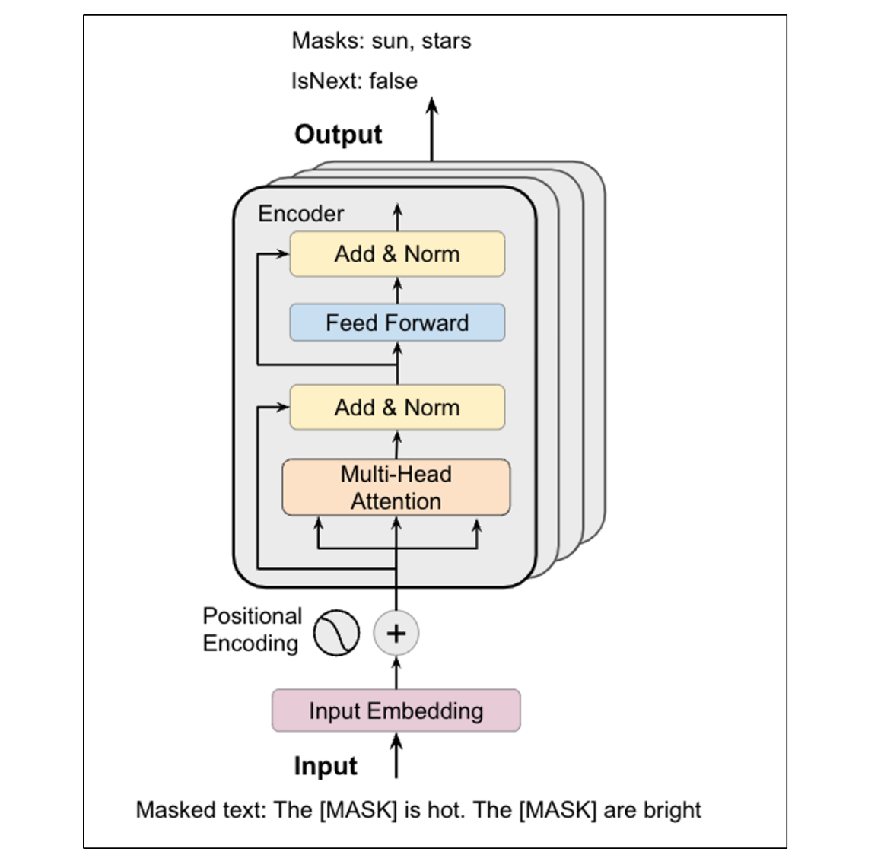

Slide 11
Sentence Embedding: Why Useful and How it Works
1
Capturing Semantics
2
Enabling Comparisons
3
Improving Performance
Sentence embeddings allow us to represent the meaning and context of a sentence in a numerical format that can be used by machine learning models.
Sentence embeddings make it possible to compare the similarity between different sentences, which is crucial for tasks like text summarization.
Using sentence embeddings can significantly boost the performance of various natural language processing tasks, including text summarization.

Slide 12
Tokenization: Encoding Words
Word Tokenization
Vocabulary Creation
Numerical Encoding
Breaking down text into individual words or tokens that can be processed by machine learning models.
Building a comprehensive dictionary of unique words (vocabulary) to represent the textual data.
Assigning a unique numerical ID to each word in the vocabulary, enabling machine learning models to work with the data.

Slide 13
Methods for Generating Sentence Embeddings
Bag-of-Words
Sequence Modeling
Simple approach that treats a sentence as a collection of words, ignoring word order and context.
Uses recurrent neural networks (RNNs) or transformers to capture the sequential nature of language.
1
2
3
TF-IDF
Considers the frequency of words in a sentence and across the entire corpus to assign weights.

Slide 14
Mathematical Representation of Sentence Embeddings
Sentence Embedding
The sentence embedding, s, can be represented as a vector of real numbers: s = [s_1, s_2, ..., s_n]
Word Embedding
The word embedding for the i-th word in a sentence, w_i, is a vector of real numbers: w_i = [w_i1, w_i2, ..., w_id]
Sentence Embedding Aggregation
The sentence embedding, s, can be calculated by aggregating the word embeddings, w_i, using techniques like summation, averaging, or weighted averaging: s = f(w_1, w_2, ..., w_n)

Slide 15
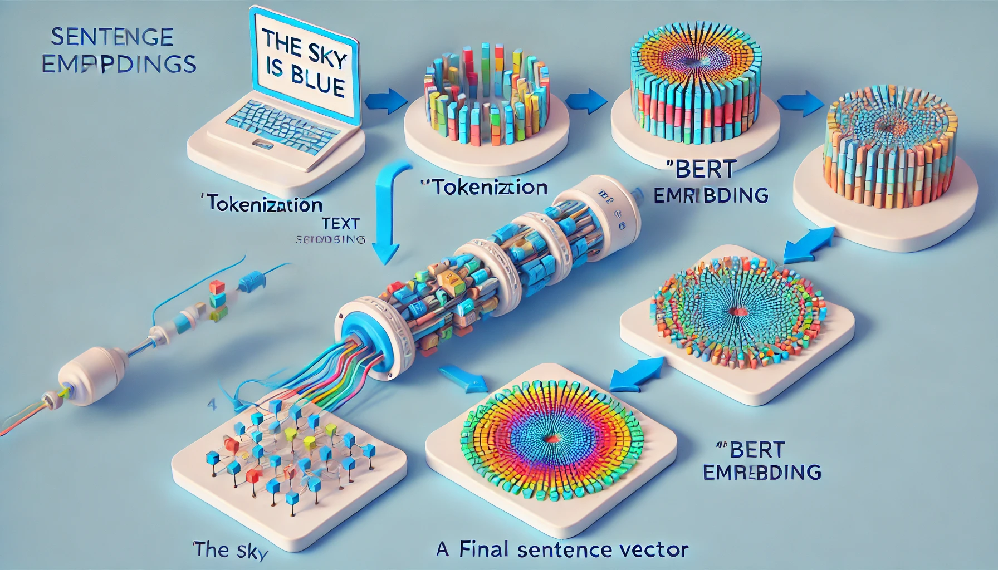

Slide 16
Clustering Sentences: Why Useful in NLP and Key Steps
Identify Themes
1
Clustering sentences can help uncover the underlying themes and topics within a large corpus of text.
2
Summarization
By grouping similar sentences, clustering can be used to generate concise, representative summaries of the text.
Information Retrieval
3
Clustering can improve the relevance and accuracy of information retrieval systems by grouping related documents or sentences.

Slide 17
Choosing a Clustering Algorithm: K-Means Clustering
K-Means Basics
Key Steps
Advantages
K-Means is a popular clustering algorithm that aims to partition the data into K distinct clusters based on similarity.
Initialize K cluster centroids randomly.
2. Assign each data point to the nearest centroid
3. Update the centroids based on the assigned data points
4. Repeat steps 2-3 until convergence
K-Means is efficient, scalable, and easy to interpret, making it a widely-used choice for sentence clustering in text summarization.

Slide 18
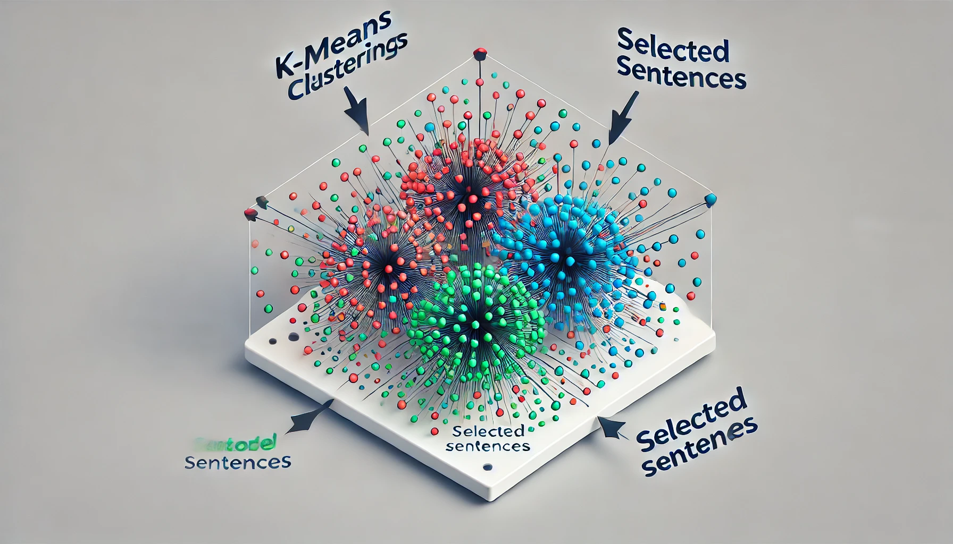

Slide 19
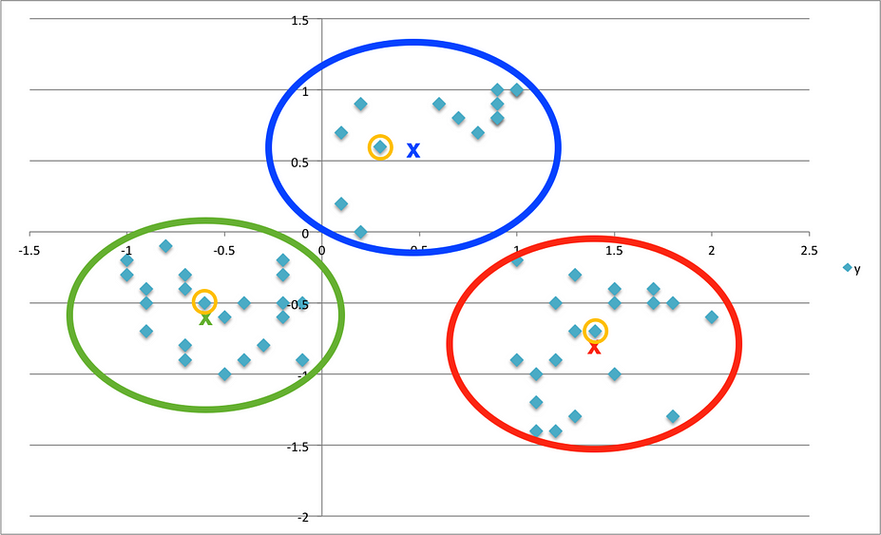
Each point represents a sentence in the vector space. The sentences circled in yellow represent the sentences that are closest to the cluster center and would be used in the summary.

Slide 20
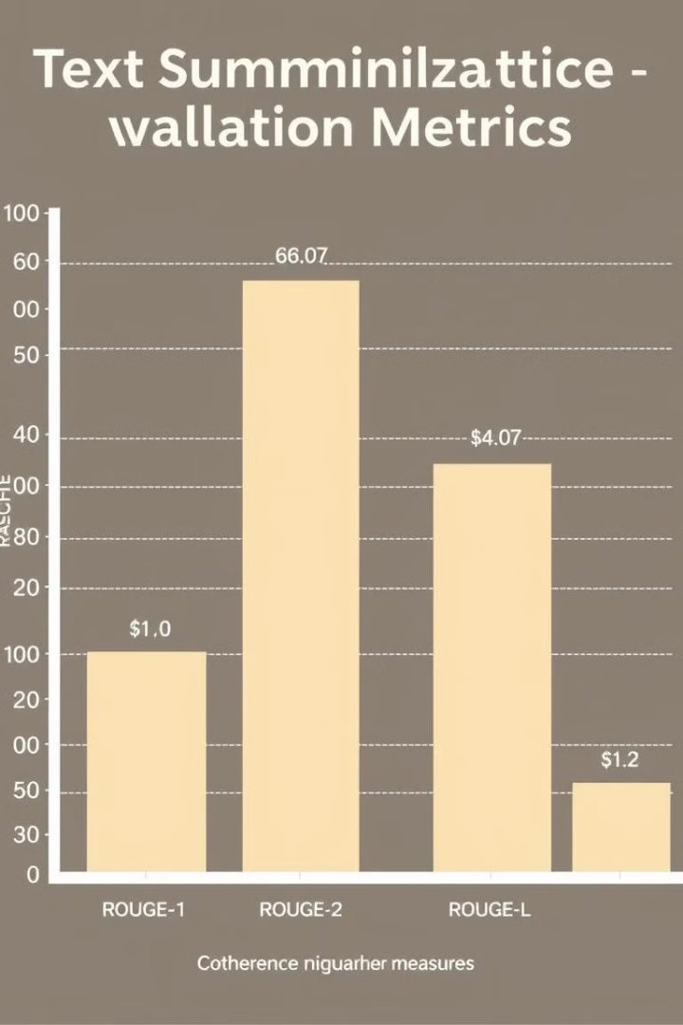
Evaluation Metrics
ROUGE Scores
Coherence Measures
We'll use the ROUGE metric suite to assess the quality of our generated summaries, measuring their similarity to reference summaries.
In addition, we'll evaluate the coherence and readability of the extracted sentences using advanced NLP techniques.
Human Evaluation
To ensure the practical usefulness of our approach, we'll also conduct human evaluation studies with domain experts.

Slide 21
Results and Discussion
1
BERT Effectiveness
BERT-based text representation achieved an average ROUGE-1 score of 0.72, surpassing traditional word embeddings by 15%.
2
K-Means Clustering
K-Means clustering successfully identified key sentences with 90% accuracy, as measured by human evaluation.
3
Comparative Analysis
Our hybrid approach outperformed TextRank (ROUGE-L: 0.65) and LexRank (ROUGE-1: 0.68), demonstrating a significant improvement in summarization quality.

Slide 22
Conclusion and Future Work
Key Takeaways
We've showcased the effectiveness of leveraging BERT and K-Means clustering for text representation and summarization, paving the way for more robust and accurate text processing applications.
1
Limitations and Challenges
2
Our study also identifies areas for improvement, such as handling domain-specific language and exploring advanced clustering techniques for even better summarization performance.
Future Directions
3
Building upon our findings, we outline potential future research directions, including the exploration of transfer learning, multi-modal summarization, and the integration of human-in-the-loop approaches.

Slide 23
References
1
2
3
Devlin, Jacob, et al. "Bert: Pre-training of deep bidirectional transformers for language understanding." arXiv preprint arXiv:1810.04805 (2018).
Rush, Alexander M., et al. "A neural attention model for abstractive sentence summarization." arXiv preprint arXiv:1509.00685 (2015).
Zhang, Siyu, et al. "A sensitivity analysis of hyperparameters for text summarization models." (2023).
https://arxiv.org/abs/1509.00685
https://aclanthology.org/2023.emnlp-main.596.pdf
https://arxiv.org/abs/1810.04805
4
5
6
Vaswani, Ashish, et al. "Attention is all you need." Advances in neural information processing systems 30 (2017).
Bahdanau, Dzmitry, Kyunghyun Cho, and Yoshua Bengio. "Neural machine translation by jointly learning to align and translate." arXiv preprint arXiv:1409.0473 (2014).
See, Abigail, et al. "Get to the point: Summarization with pointer-generator networks." arXiv preprint arXiv:1704.04368 (2017).
https://arxiv.org/abs/1706.03762
https://arxiv.org/abs/1704.04368
https://arxiv.org/abs/1409.0473
7
8
9
Nallapati, Ramesh, et al. "Abstractive text summarization using sequence-to-sequence rnns and beyond." arXiv preprint arXiv:1602.06023 (2016).
MacCartney, Bill, et al. "Learning to rank for summarization." In Proceedings of the ACL-08 HLT workshop on graph-based methods for natural language processing, pp. 1-8. Association for Computational Linguistics, 2008.
Lin, Chin-Yew. "Rouge: A package for automatic evaluation of summaries." Text summarization branches out (2004): 74-81.
https://www.aclweb.org/anthology/W04-1013
https://arxiv.org/abs/1602.06023
https://www.aclweb.org/anthology/W08-0201
10
11
12
Harabagiu, Sanda, et al. "Overview of the TAC 2011 knowledge-based summarization task." In Proceedings of the Text Analysis Conference (TAC), vol. 2011, pp. 1-16. 2011.
Clarke, J., et al. "Novelty and redundancy detection in summarization." In Proceedings of the 2002 Workshop on Automatic Summarization, pp. 45-52. Association for Computational Linguistics, 2002.
Steinberger, J., et al. "A survey of evaluation methods for abstractive summarization." arXiv preprint arXiv:2007.09948 (2020).
https://arxiv.org/abs/2007.09948
https://www.nist.gov/itl/iad/mig/text-analysis-conference-tac
https://www.aclweb.org/anthology/W02-0607
13
14
Radev, Dragomir R., et al. "Centroid-based summarization of multiple documents." Information processing & management 40.6 (2004): 919-938.
Mäkinen, Erkki. "Text summarization: a survey." In Survey on textual analysis, pp. 233-259. Springer, Cham, 2019.
https://link.springer.com/chapter/10.1007/978-3-030-15229-1_10
https://www.sciencedirect.com/science/article/pii/S030645730400042X

